Slide 1
Emotion Classification with BERT
Building a Deep Learning Model on the MELD Dataset

Slide 2

Introduction
This presentation outlines a project focused on developing a deep learning model for emotion classification using the MELD dataset, employing the BERT transformer model for textual analysis.

Slide 3
01
Objective

Slide 4

Build text-based emotion classifier
The main goal is to develop a classifier that accurately detects emotions present in dialogue utterances derived from the MELD dataset. This involves using BERT to analyze and interpret these texts, providing insights into various emotional expressions.

Slide 5
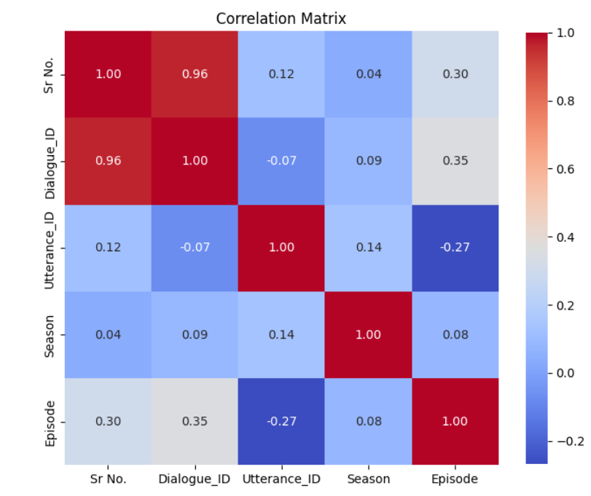
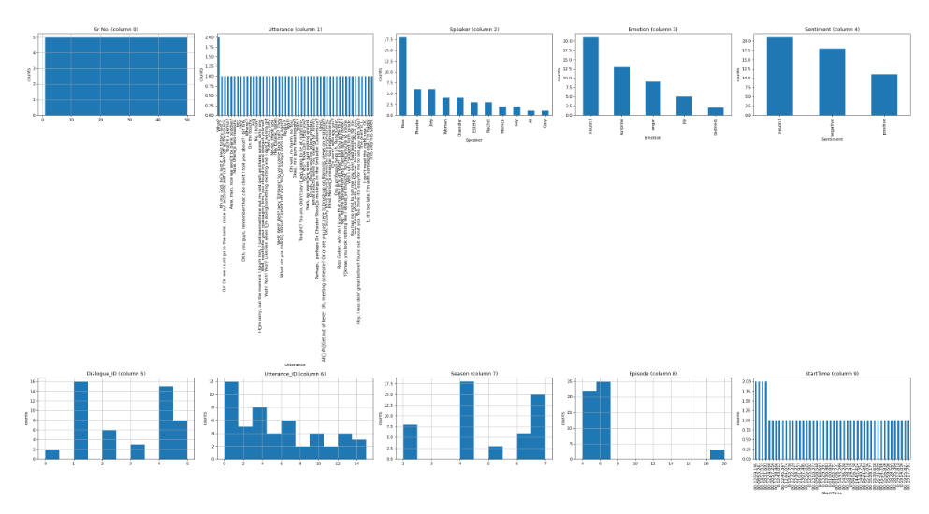

Slide 6
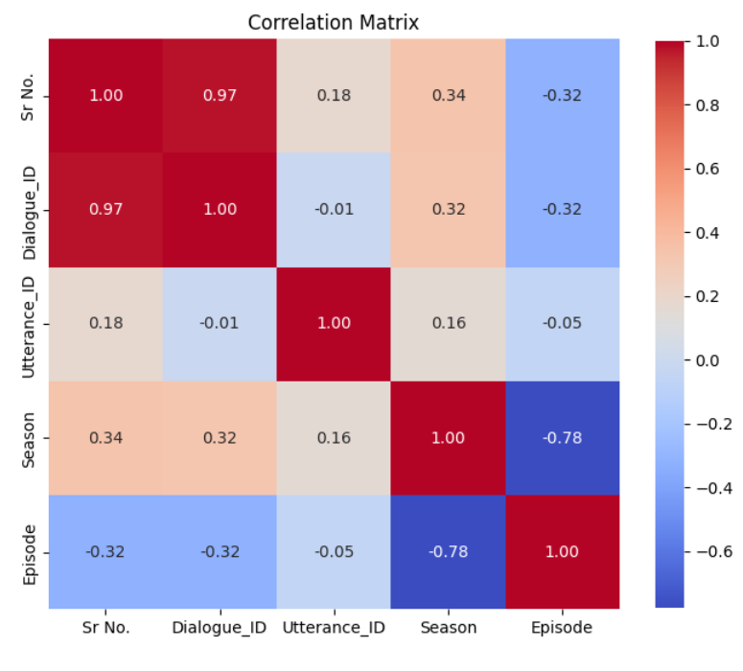
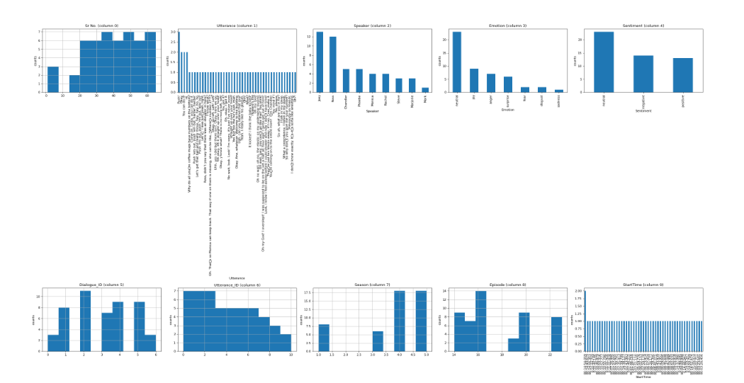

Slide 7
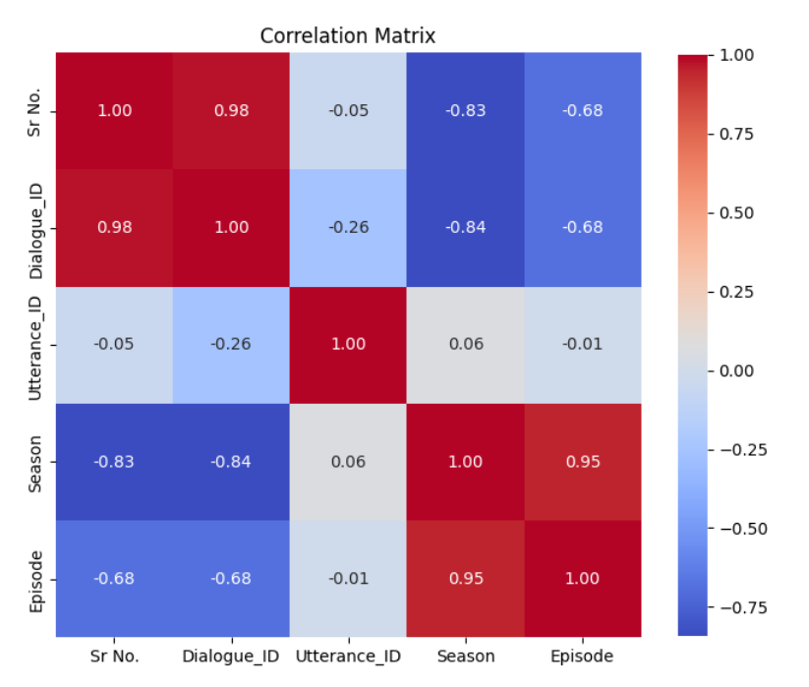
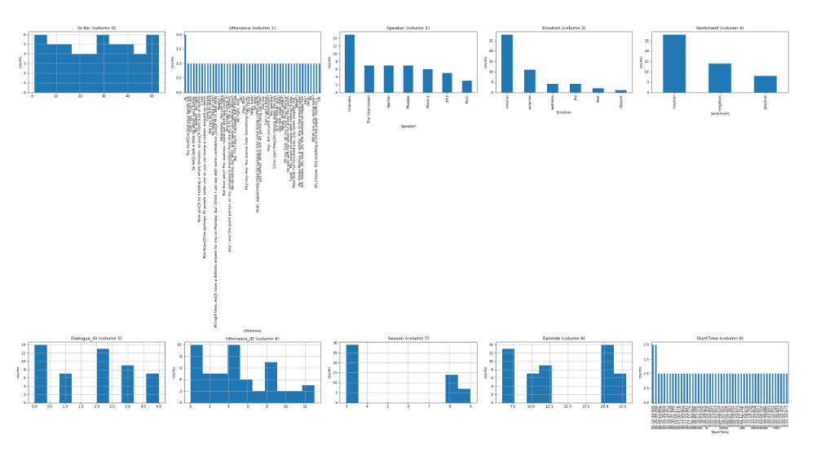

Slide 8
Fine-tune BERT on MELD labels
The project aims to fine-tune the BERT model to classify emotions from multi-party conversations within the dataset. This process includes optimizing the model's parameters based on the labeled data corresponding to different emotions such as joy, sadness, anger, and more.

Slide 9
Analyze training dynamics
Analysis of training dynamics entails monitoring the model's performance metrics across training epochs. This includes observing training loss and validation accuracy to ensure the model converges properly. Any fluctuations or instabilities in validation performance can indicate issues such as overfitting or the need for hyperparameter adjustments.

Slide 10
02
Workflow

Slide 11

Data loading and preprocessing
The initial workflow involves loading the MELD dataset, which consists of multiple CSV files representing training, validation, and test splits. Key preprocessing steps include removing rows with missing labels and encoding the emotion labels into a numerical format using LabelEncoder, ensuring the data is ready for modeling.

Slide 12
Model architecture and training loop
The model structure is built using BERT for sequence classification, with a classification head added above the [CLS] token embedding. The training loop integrates custom functions for training and evaluation, employing the AdamW optimizer for effective learning rate management while tracking performance throughout the training process.

Slide 13
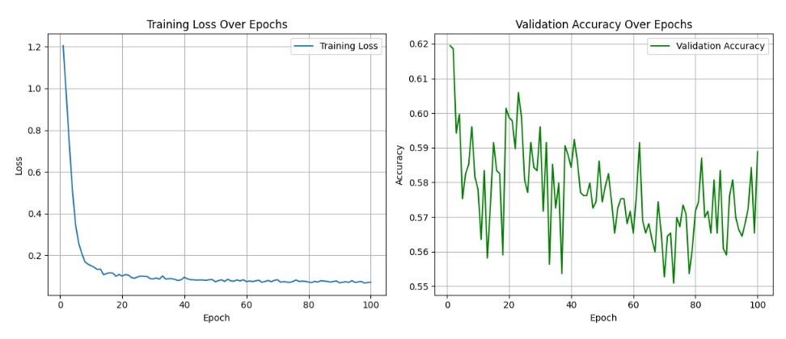
Evaluation and metrics tracking
Model evaluation is carried out by generating classification reports on validation and test sets, focusing on key metrics such as precision, recall, and F1-score for each emotion category. These metrics are essential for understanding model performance and generalization capabilities.

Slide 14
Conclusions
In summary, the process of building an emotion classifier using BERT on the MELD dataset involves meticulous steps from data preprocessing to model evaluation. By continuously analyzing training dynamics and performance metrics, the model can be fine-tuned for optimal accuracy in emotion detection.

Slide 15
Thank you!
Do you have any questions?
+91 620 421 838

